Slide 1

Object-Oriented Programming (OOP) Concepts in Python
TOPS TECHNOLOGIES
Submitted by:- Ruchit Thummar

Slide 2
OUTLINE
Class
Objects
Inheritance
Encapsulation
Polymorphism
Data Abstraction

Slide 3

What is OOP? (Object-Oriented Programming)
OOP is a way to organize code like real-world things using classes and objects.
It makes your programs easier to understand and manage.
Why Use OOP?
OOP helps you write clean and organized code by breaking it into small parts using classes and objects.
It allows you to reuse code easily, manage big programs without confusion, and keep important data safe from outside access.

Slide 4
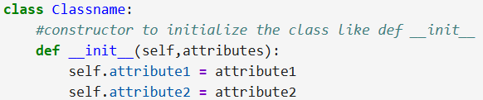
Class & Object
class - Blueprint of creating objects.
It defines properties(called attributes) and behaviors (called methods) that the object created the class can have.
Obj - Object is an instance of class.
When class is defined, no memory is allocated. When it is instantiated (Obj created),memory allocated
Syntax:-

Slide 5
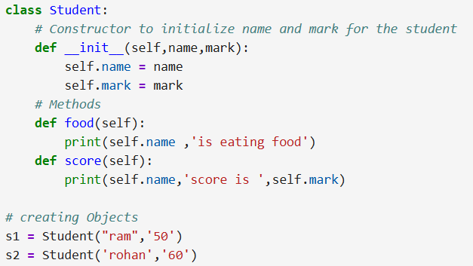
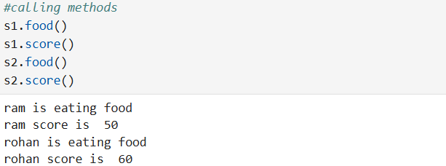
Example:-

Slide 6
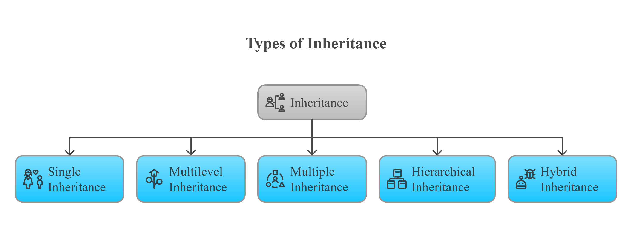
Inheritance
Allow class to inherit the attributes and methods of another class(parents class or super class) it promotes code reuse, extensibility and modularity.
There are five types of inheritance,

Slide 7
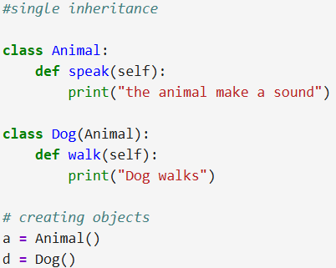
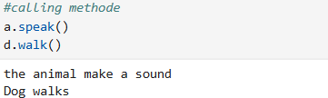
Single Inheritance
It means One child class inherits from one parent class.
Think of it like:
Parent → has common things (like name, age, etc.)
Child → gets everything from parent + adds more of its own.
Example:-

Slide 8
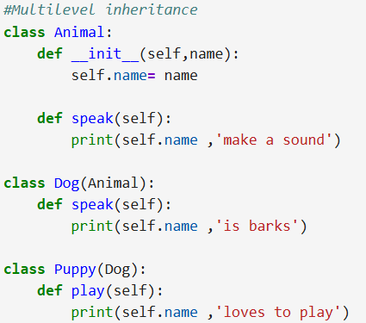
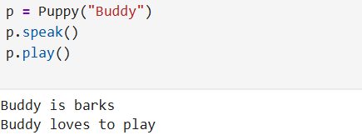
Multilevel Inheritance
It is a class inherits from a class, which itself inherits from another class.
Grandfather has a surname → Father inherits it → Child also inherits it.
Example:-

Slide 9
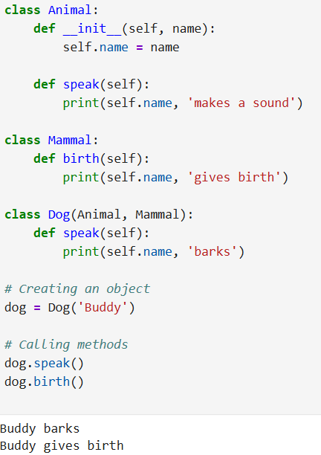
Multiple Inheritance
When a class inherits from more than one parent class, it is called multiple inheritance.
In this type, the child class receives all the attributes (variables) and methods (functions) from each of the parent classes.
Example:-

Slide 10
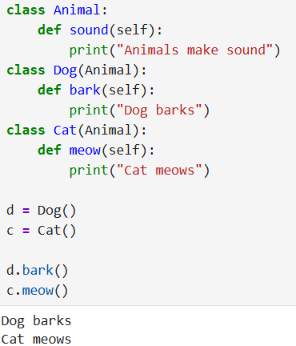
Hierarchal Inheritance
One parent class → many child classes.
Each child inherits from the same parent.
Think of it like a family tree: one parent, multiple children.
Example:-

Slide 11
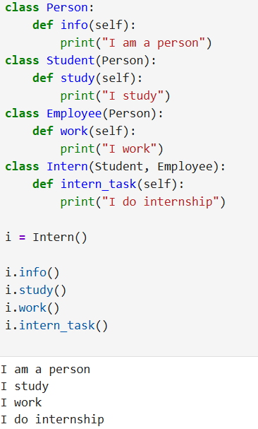
Hybrid Inheritance
Hybrid Inheritance = combination of more than one type of inheritance (for example: combination of single + multiple + hierarchical)
It’s a mix like a family tree with complex branches.
Example:-

Slide 12
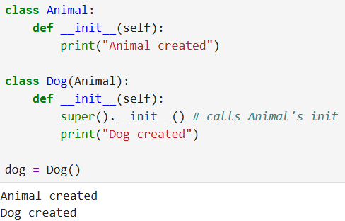
Super() Function
super() is a built-in Python function used inside a class to call methods from its parent (or superclass).
Examples:-
It is used to reuse methods from the parent class , so you don’t have to repeat the same code again .

Slide 13
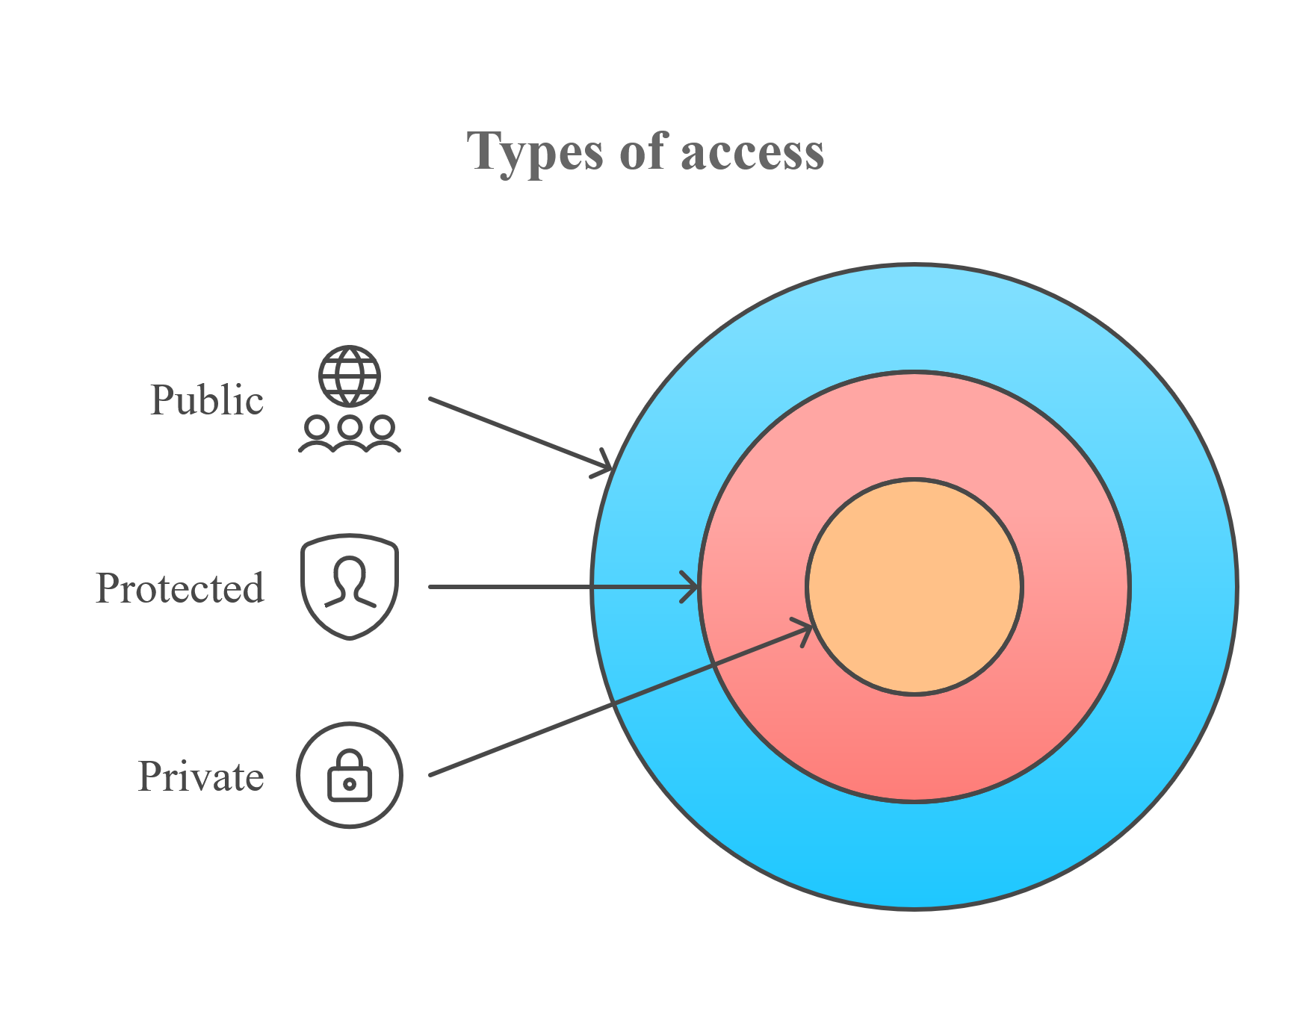
Encapsulation
Encapsulation is the process of hiding the internal details of an object and restricting direct access to some parts like data or methods.
Instead, access is given through getter and setter methods in Python.

Slide 14
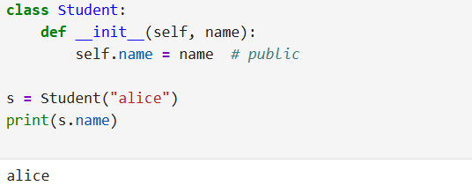
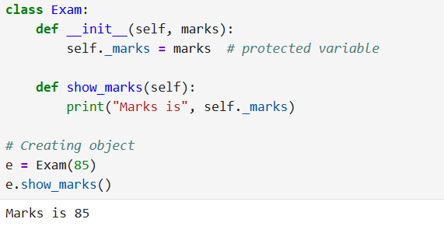
1. Public:-
It can be accessed from anywhere.
Example:-
2. Protected:-
It written with a single underscore _variable. It should not be accessed from outside the class, but it’s still technically allowed.
Example:-

Slide 15
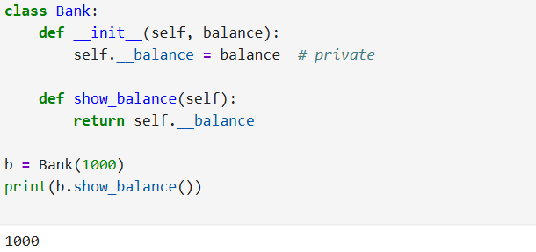
3. Private:-
It written with double underscores __variable. It is meant to be hidden and cannot be accessed directly from outside the class.
Example:-

Slide 16
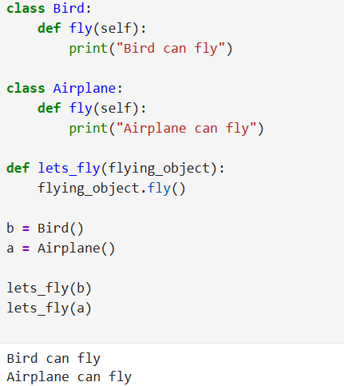
Polymorphism
Polymorphism means many forms in Python.
It means different classes can have methods with the same name, but each method works differently depending on the class.
Example:-

Slide 17
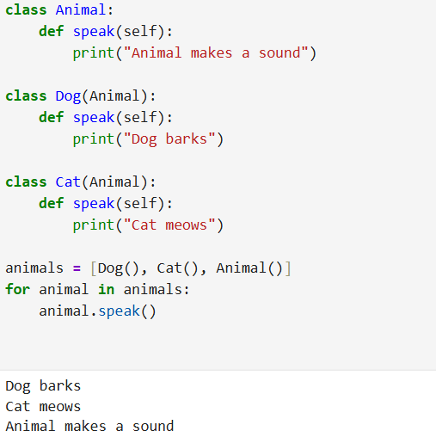
Overriding
When a child class has a method with the same name as the parent class.
the child’s method is used instead of the parent’s method for that child.
Example:-

Slide 18
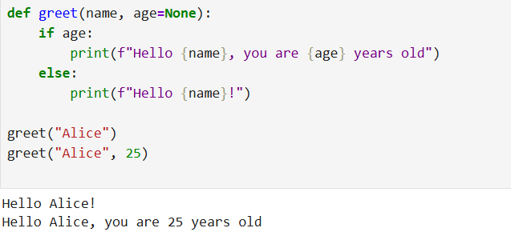
Why Python does not use method overloading?
Python methods can take any number of arguments using default values, *args, and **kwargs.
One method in Python can handle many situations using default values or special arguments.
This makes the code simpler because you don’t need to write many versions of the same method.
Python prefers simplicity and doesn’t need multiple methods with the same name.
Example:-

Slide 19
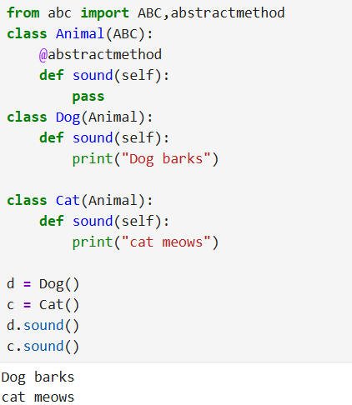
Data Abstraction
It means hiding the internal working and showing only the necessary features of an object.
It allows you to focus on what an object does, not how it does it.
Example:-

Slide 20
THANK YOU

